Slide 1

React 1

Slide 2


Slide 3
Best Way To Learn React
Start Coding !!!

Slide 4

React1-Introduction to React
What is NodeJS
NodeJS
What is ReactJS
Thinking in React

Slide 5
React2- Dive Into React
Generate a React Project
Need of create-react-app
Exploring create-react-app Project
Starting and Stopping a React App
JS Module System
Displaying Data with Functional Components

Slide 6
React Project
Folder where we put all the source code
src
Stores static files like images
public
node_modules
Folder contains all the project dependencies
package.json
Records exact version of packages we install
package-lock.json
readme.md
Instruction on how to use the project

Slide 7
React3 - JSX
What is JSX
Embedding Expressions in JSX
Specifying Attributes with JSX
Specifying Children with JSX

Slide 8
React4 -Props
Component Nesting
React's Prop System
Passing and Receiving Props
Passing Multiple Props

Slide 9
Index.js
Props Passing Not Allowed
Props Passing Allowed
App.js
BasicComment
Comments
CommentsProp
Comment
CommentProp

Slide 10
React5 - Class Based Components
What are Class Based Components
Scaffolding the App
Create Cards using Class Component
Understand how to pass Props in Class Based Component

Slide 11
Old React
Functional Components
Could only use JSX to show content. No State management
Use JSX to show content
Use lifecycle method to run code at specific point of time .
Can use state to update content on the screen.
Class Components

Slide 12
React6-State in React
The state contains data specific to a particular component
The state is user-defined, and it should be a plain JavaScript object.
State is mutable.

Slide 13
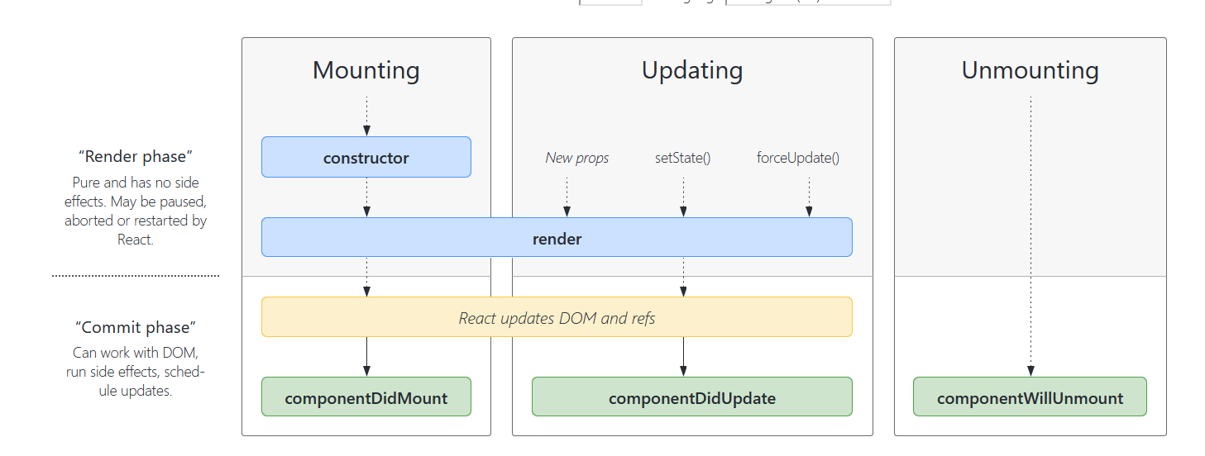
React6- Component Lifecycle
Source: https://projects.wojtekmaj.pl/react-lifecycle-methods-diagram/

Slide 14
React7-Lifecycle Methods
constructor()
render()
componentDidMount()
componentDidUpdate()

Slide 15
Exercise-1
Create a react app
Define customer information in
App.js as
const customer = {
first_name: 'Bob',
last_name: 'Dylan’
};
Create a component CustomerInformation.jsx that receives customer as props and display the information in CustomerInformation.jsx

Slide 16
Exercise-2
Create a react app
Define array in App.js as
const animals = [Horse,Turtle,Elephant,Monkey];
Display the array data in App.js after
Looping over the array. Use map or ForEach. Solve the key issue.

Slide 17
Exercise-3
Complete exercises from https://www.w3schools.com/react/exercise.asp
React JSX
React Components
React Props
React Events
React Conditionals
React Lists

Slide 18
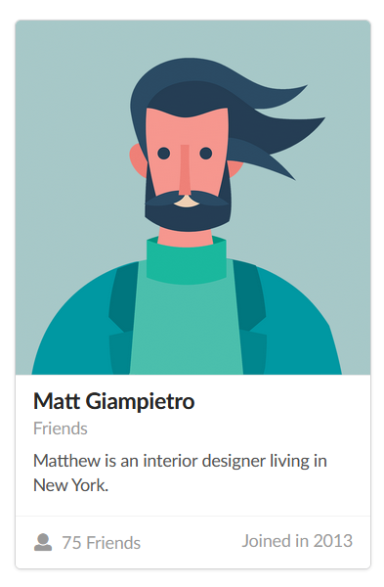
Homework-1
Create a react app
Create a Bio Card
Use semantic UI and faker
Expected Output: https://semantic-ui.com/views/card.html
Use Class Based Components

Slide 19


Slide 20

Questions?
JavaScript 1

